Slide 1
British Airways Customer Reviews Analysis
Predictive modeling of customer bookings
Prepared by: [Ankit Shankhala]

Slide 2
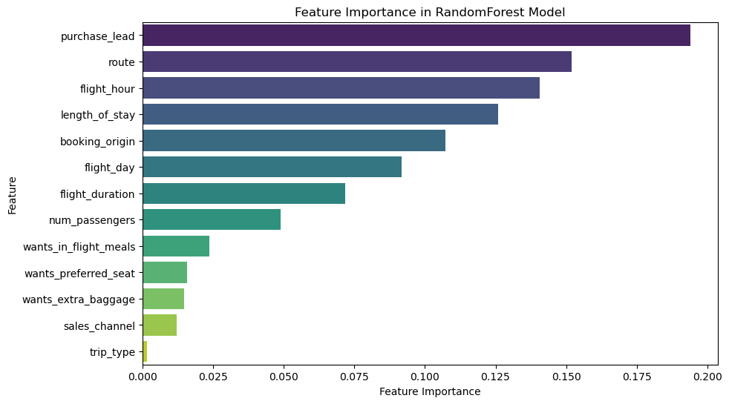
Feature Importance in Random Forest Model

